Slide 1
Trekr
Jonathan Harris, Derek Kidd, Ethan McKenzie, Ryan Thomas
Notes:
Ryan

Slide 2
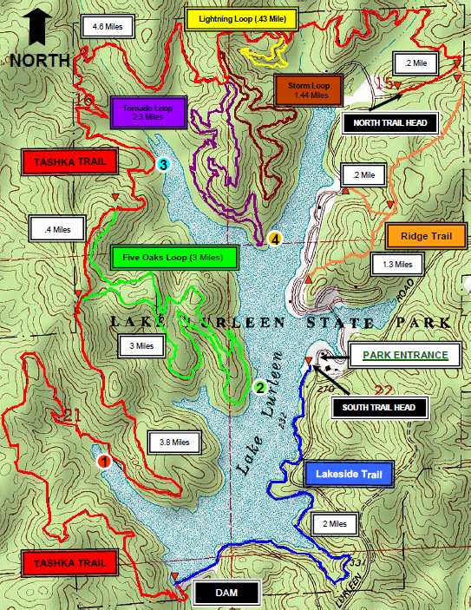
Problem Definition
Physical maps are typically maintained by a park association or volunteer group which tends to lead to maps that are out of date
Physical maps require frequent effort to maintain
Users of the trails are unable to provide updates or mark interesting points on a trail
User location on map may be hard to determine without the use of technology.
Notes:
Jonathan

Slide 3

Scope
Our target users include hikers, mountain bikers, geocachers, and outdoor enthusiast
Family and friends of the target users benefit from the emergency feature
Trekr provides a dynamic system for trails and points of interest
Users do not have to wait for trail updates from a park association or volunteer group
Users are able to precisely determine their geographical location as well as relation to other trails and points of interest
Notes:
Jonathan

Slide 4
Updated Class Diagram
Notes:
Jonathan

Slide 5
Sequence Diagram
Add/Edit Trail
Notes:
Derek
The edit/add trail sequence diagram describes the user's ability to manage the set of trails that are stored in the database. The add trail functionality allows a user to begin recording a new trail which will be added to the database upon entering metadata. For the edit trail functionality, a user is given the alternative to edit information about a trail such as the trail's name, description, and any notes they may have regarding the trail; or rerecord a trail in the case that the trail has changed.

Slide 6
Sequence Diagram
Select Trail/POI
Notes:
Derek
When a user wants to select a trail or a number of points of interest, they will press the Trail/POI List button located in the Main Activity. This will start the TrailPOIListView fragment as an overlay on the Main Activity. At this point, the user will manipulate the TrailPOIListView to indicate which elements should be drawn on the map. These elements are then returned to the Main Activity which updates the UI for the user.

Slide 7
Sequence Diagram
Add/Edit POI
Notes:
Ethan
The add/edit POI sequence diagram describes how a user manipulates and creates POIs. From the main activity, the user would select the options menu and choose either “Add POI” or “Edit POI.” If the user chooses “Add POI,” the POI Info Overlay is started which allows the user to position a marker on the map. Once the marker has been positioned, the POI Info Overlay requests metadata about the point of interest. If the user chooses “Edit POI,” they will be presented with a POI list from which they will select a desired POI. The POI Info Overlay is started, and the user is able to edit information regarding the point of interest.

Slide 8
Sequence Diagram
Backtrack
Notes:
Ethan
For the Backtrack functionality of Trekr, the Main Activity first detects that the user has deviated from a known trail and starts the recording overlay. The recording overlay is displayed and begins logging the user’s location. Once the user has completed the recording activity and wants to save the new trail, a trail info request is performed by the recording overlay which asks for metadata about the new trail.

Slide 9
Sequence Diagram
Emergency Mode
Notes:
Ryan
A user can engage the emergency mode functionality by selecting it from the options menu. This will display the emergency activity to the user and allow the user to optionally send a message requesting help.

Slide 10
Sequence Diagram
Search Trail/POI
Notes:
Ryan
From the Main Activity, the user selects the Trail/POI List button which starts the Trail/POI ListView. The user then utilizes the search bar to enter a keyword which will be used to query the database. The results from this query will be used to update the Trail/POI ListView.

Slide 11
Priority Focus Changes
Notes:
Ethan
Primary focus of development is currently shifted to implementing functional requirements
Likelihood of abandoning certain low priority features are becoming greater as the semester continues

Slide 12
Summary
Notes:
Derek

